Slide 1
Seminar on
Digital Signature
Gov.Polytechnic College Meppadi
Name:Krishnendu.P
Branch:Computer Engineering
Reg no:19131920

Slide 2
Content
● Introduction
● What is Digital Signature
● Purpose of Digital Signature
● Basic Concepts

Slide 3
● working
● Applications
● Advantages
● Drawbacks
● Conclusion

Slide 4
Introduction
● The authenticity of many legal, financial,and other documents is determined by
the presence or absence of an authorized handwritten signature.
● Various methods have been devised to solve this problem, but the use of ‘digital
signature’ is definitely the best solution
amongst them.
● A digital signature is nothing but an attachment to any piece of electronic
information, which represents the content of the document and the identity
of the originator of that document uniquely.

Slide 5
What is Digital Signature
● A digital signature is a mathematical scheme for everything
the authenticity of digital message or document.
● A digital signature is equivalent to a handwriting signature.
● Digital Signature is basically a way to ensure that an electronic
document ( email, spreadsheet, text file, etc) is authentic.

Slide 6
Purpose of Digital Signature
● Authentication
● Non repudiation
● Integrity

Slide 7
Basic Concepts
● Encryption - Is the process of converting data or plain text to an encrypted
or unreadable or understandable text form.
● Decryption - converting Cypher text to readable or plain text.
● Asymmetric key - is a cryptographic system that uses pairs of keys such as
Public and private key.

Slide 8
● Private Key
The private key is one which is accessible only to the signer. It is used to generate the
digital signature which is then attached to the message.
● Public Key
The public key is made available to all those who receive the signed messages from the
sender. It is used for verification of the received message.

Slide 9
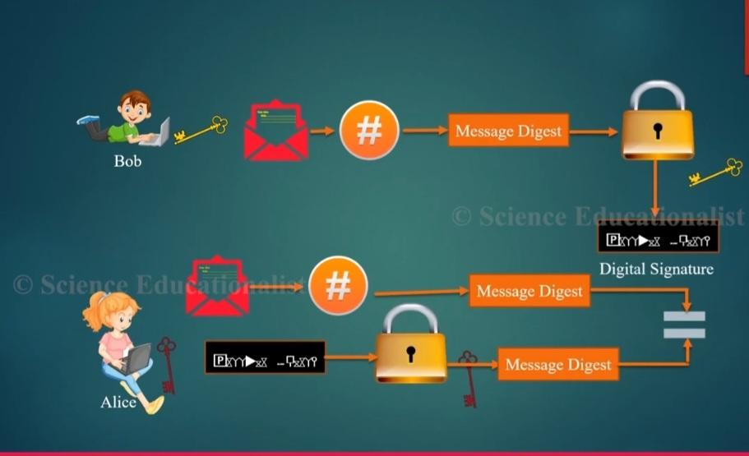
Working

Slide 10
● Bob wants to send a message to Alice, for this purpose Bob uses a secure
hash function to generate a hash value for the message.
● And encrypt the hash code with his private key creating a digital signature.
● Bob sends the message with the signature attach,when Alice receive the
Message + signature, Alice calculate the hash value for the message decrypt
the signature using Bob's public key.
● Compares the calculated hash value to the decrypted hash value match, Alice
assured that the message must have been signed by Bob.

Slide 11
Applications
● Electronic Mail
● Data storage
● Electronic funds transfer
● Software Distribution

Slide 12
Advantages
● Easier and faster payment
● Saves both cost and time
● Security enhanced
● Authenticity

Slide 13
Drawback
● The private key must be kept in a secured manner.
● The process of generation and verification of digital signature requires
considerable amount of time.
● For using the digital signature the user has to obtain private and
public key, the receiver has to obtain the digital signature certificate
also.

Slide 14
Conclusion
Digital signatures are difficult to understand. Digital signatures will be
championed by many players that the public distrusts, including national
security agencies, law enforcement agencies, and consumer marketing
companies.

Slide 15
THANKS

